Slide 1

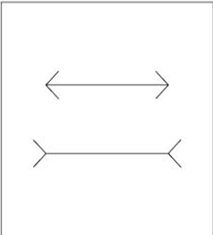
Digital Image Processing
7-give an example for an image that gives an optical illusion for the eye.
The two horizontal line segments in Fig. are of the same length,
but one appears shorter than the other.

